Slide 1
Time Americans Spend Sleeping
File created on: 1/28/2022 10:56:34 PM

Slide 2


Slide 3


Slide 4
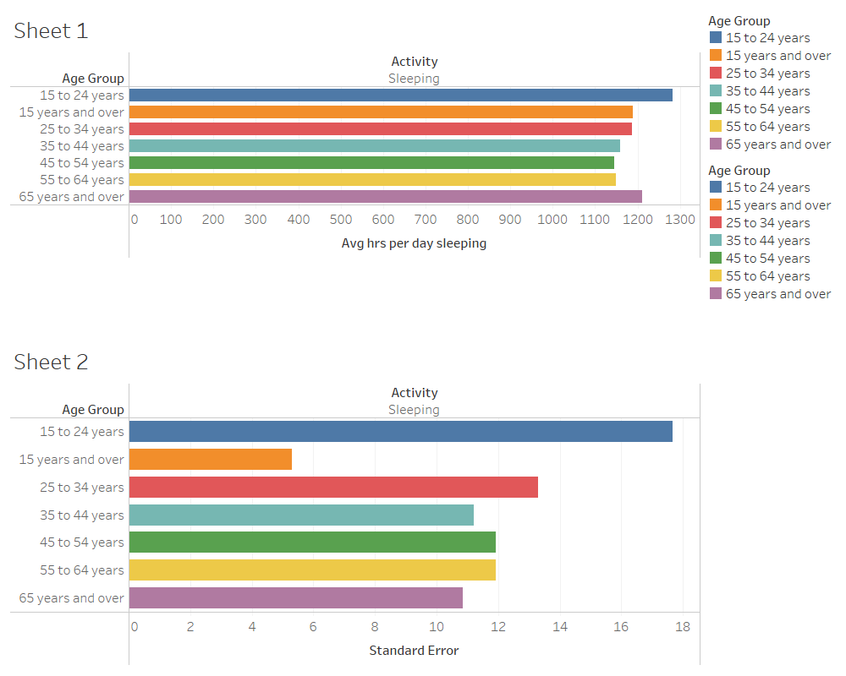

Slide 5
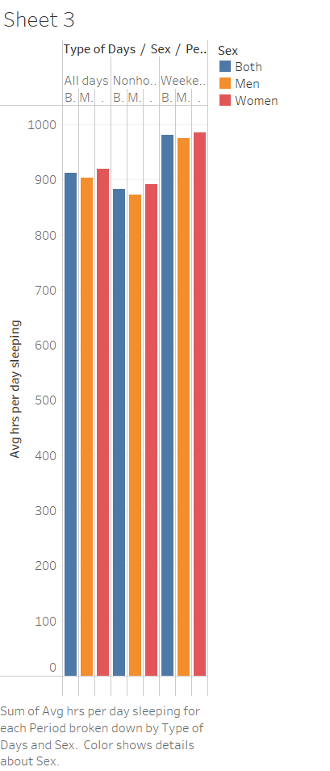

Slide 6


Slide 7
